Slide 1

Raspberry Pi Sensors and Security More Fun with Pi
By Chuck Duey
Feb 13th 2019
TM Raspberry Pi Foundation www.raspberrypi.org

Slide 2
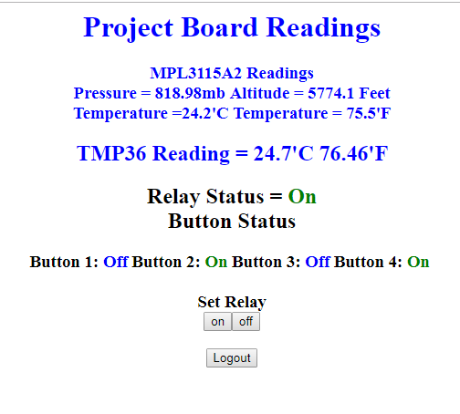
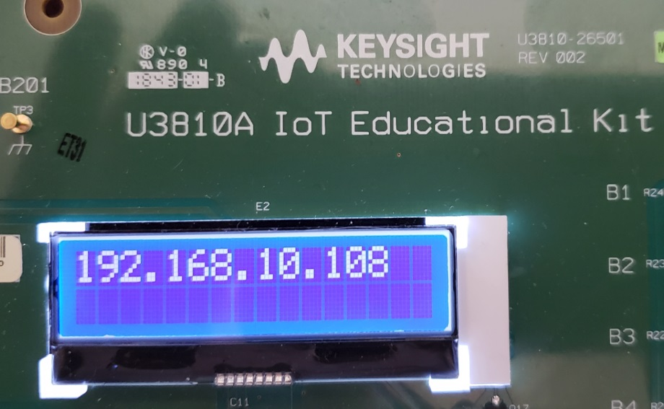
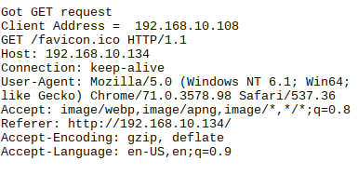
This is What We are Doing Today
Languages used today: Python, C/C++, HTML, bash, and php.

Slide 3
Outline:
TM Raspberry Pi Foundation www.raspberrypi.org
Different Hardware platforms.
Tips and Tools for the Raspberry Pi.
Detailed tour of the I/O ports and how to connect.
GPIO Relay and Buttons.
I2C Devices. Hook up Pressure and Temp sensor.
I2C Devices LCD display and making Python Functions.
Bit Banged SPI and ADC using C programming.
Making a C program into a Python Function.
Getting on the Network IOT Security.
Creating and Opening Sockets.
Working with Port 80 aka HTTP
Making a secure HTTPS site for a Raspberry Pi Project.

Slide 4
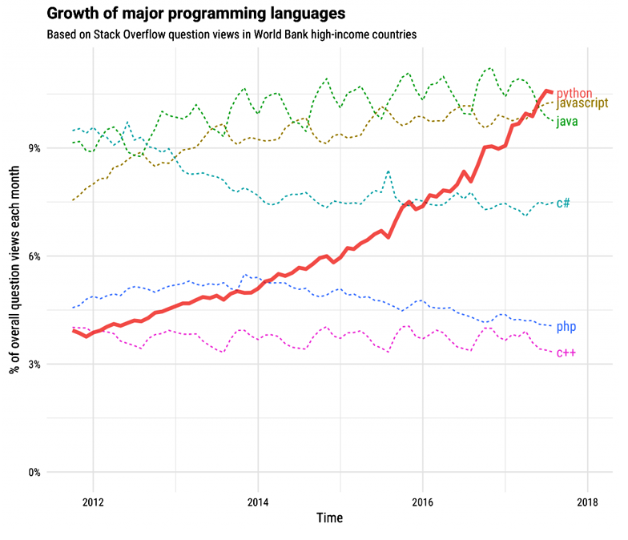
Major Programming Languages

Slide 5
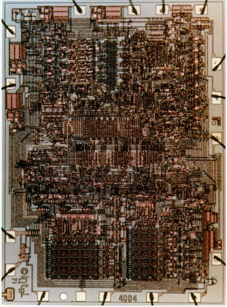
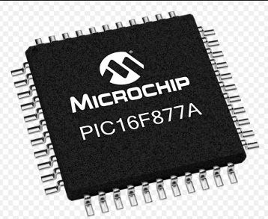
Microchip PIC or other Standalone Microprocessor
Advantages
Targeted size and function. Right for the job.
Low cost.
Support from the manufacturer.
Full custom design. Can make very small.
Disadvantages
Need to build circuitry.
Not much Open-source hardware or software
Need to pay for high level language cross compilers.

Slide 6
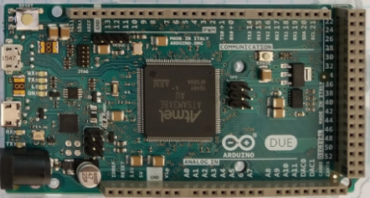
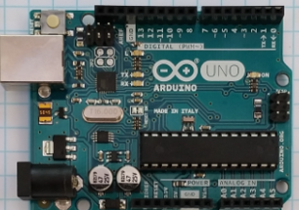
Arduino
Advantages
Many different I/O’s built in.
Very nice IDE. (Integrated Development Environment)
Huge opensource community for both hardware and software.
Many premade shields and hardware add-ons.
Disadvantages
Smaller low speed microprocessors
No operating system
One programming language C/C++

Slide 7
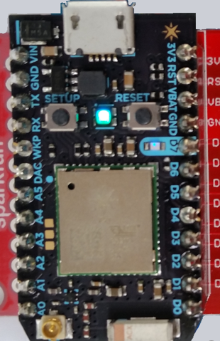
Particle Photon
Advantages
Very small and low power
Uses Arduino like IDE and language.
Is a WiFi device. Very easy to make IoT device.
Full custom design. Can make very small.
Disadvantages
Can only program over the internet.
One processor size and speed 120MHz.
One programming language C/C++.
Must have internet connection to start. (use WiFi Hotspot)

Slide 8
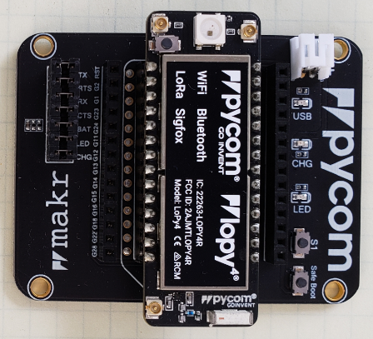
PyCom Boards
Advantages
Very small and low power
Multiple IO 8 X 12 Bit ADC 2x I2C, 2x UART, SPI, GPIO
uPython environment using Atom IDE
Built in AES,DES, and SHA/MD5 Hash
Is Multi standard wireless connections.
Antenna connections for long range
Standalone modules available.
Disadvantages
No Operating system difficult to multi task
One programming language uPython.
Need adapter board to program and connect to I/O.
Difficult to set up dynamic webpages.

Slide 9
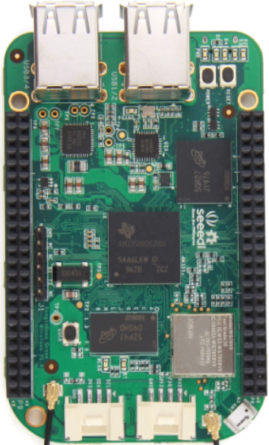
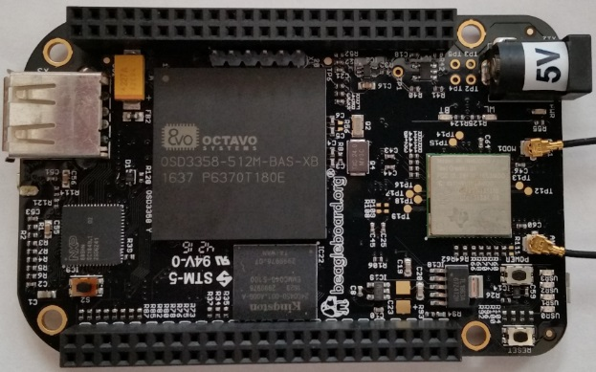
BeagleBone
Advantages
Linux operating system. Can program in many languages and interact with the internet.
Can make Webpages and run full LAMP stack.
Open source software and hardware support.
Fast ARM core processor.
The Black Version has a micro HDMI display.
Analog inputs.
Disadvantages
Display resolution not that good.
Single Core ARM Processors.
Operating system overhead.
Costs more than Raspberry Pi
Community support is not as wide as Raspberry Pi
Operating system and Overlays not as stable.

Slide 10
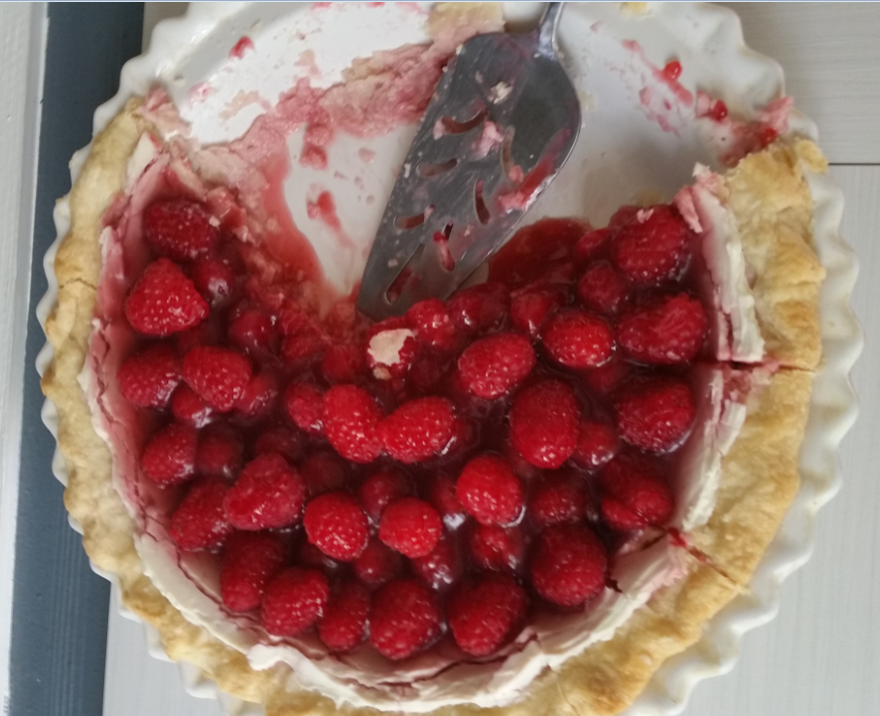
Time to talk about Raspberry Pie

Slide 11
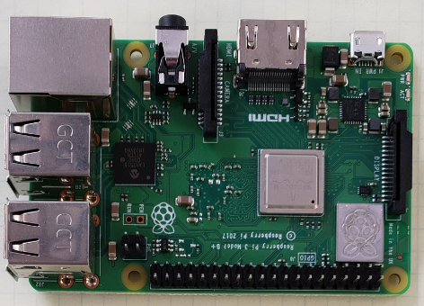
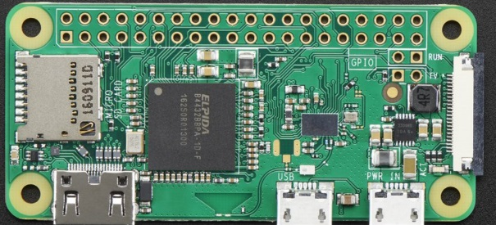
Raspberry Pi
Advantages
Linux operating system. Can program in many languages and interact with the internet.
Can make Webpages and run full LAMP stack.
Massive open source software and hardware support.
Very fast ARM core processor.
Easy to implement GUI’s for interactive programs.
Disadvantages
Need to add on hardware for Analog inputs!
Power hungry when compared to other micro controllers. Battery Power is not recommended.
Operating system overhead.

Slide 12
Difference between the Raspberry Pi Versions
Model | Zero/W | B | Pi 3 A+ | B+ | Pi 2 | Pi 3 | Pi 3+ | Pi 4
CPU | Arm 6 1000MHz | Arm 6 700MHz | 4xArm 53 1400MHz | Arm 6 700MHz | 4xArm 7 900MHz | 4xArm 8 1200MHz | 4xArm 53 1400MHz | 4xArm 72 1500MHz
RAM | 512MB | 512MB | 512MB | 512MB | 1GB | 1GB | 1GB | 1GB/2GB/4GB
USB | 1 | 2 | 1 | 4 | 4 | 4 | 4 | 2-2.0 2-3.0
Network | None/WiFi | 10/100 | WiFi | 10/100 | 10/100 | 10/100 WiFi bg | 10/300 WiFi abg | 10/100/1G WiFi abg
Video | HDMI | HDMI/NTSC/PAL | HDMI/NTSC/PAL | HDMI/NTSC/PAL | HDMI/NTSC/PAL | HDMI/NTSC/PAL | HDMI/NTSC/PAL | 2XHDMI NTCS/PAL
Hardware IO | 25 | 17 | 25 | 25 | 25 | 25 | 25 | 25
+5V Supply | 500mA | 1A | 1A | 1A | 1.5A | 2.0A | 2.5A | 3.0A
Bluetooth | Yes/W | No | Yes | No | No | Yes | Yes | Yes
SD Card | Micro | Mini | Micro | Micro | Micro | Micro | Micro | Micro
Cost | $5/$10 | $30* | $25 | $25 | $35 | $35 | $35 | $35/$45/$55

Slide 13
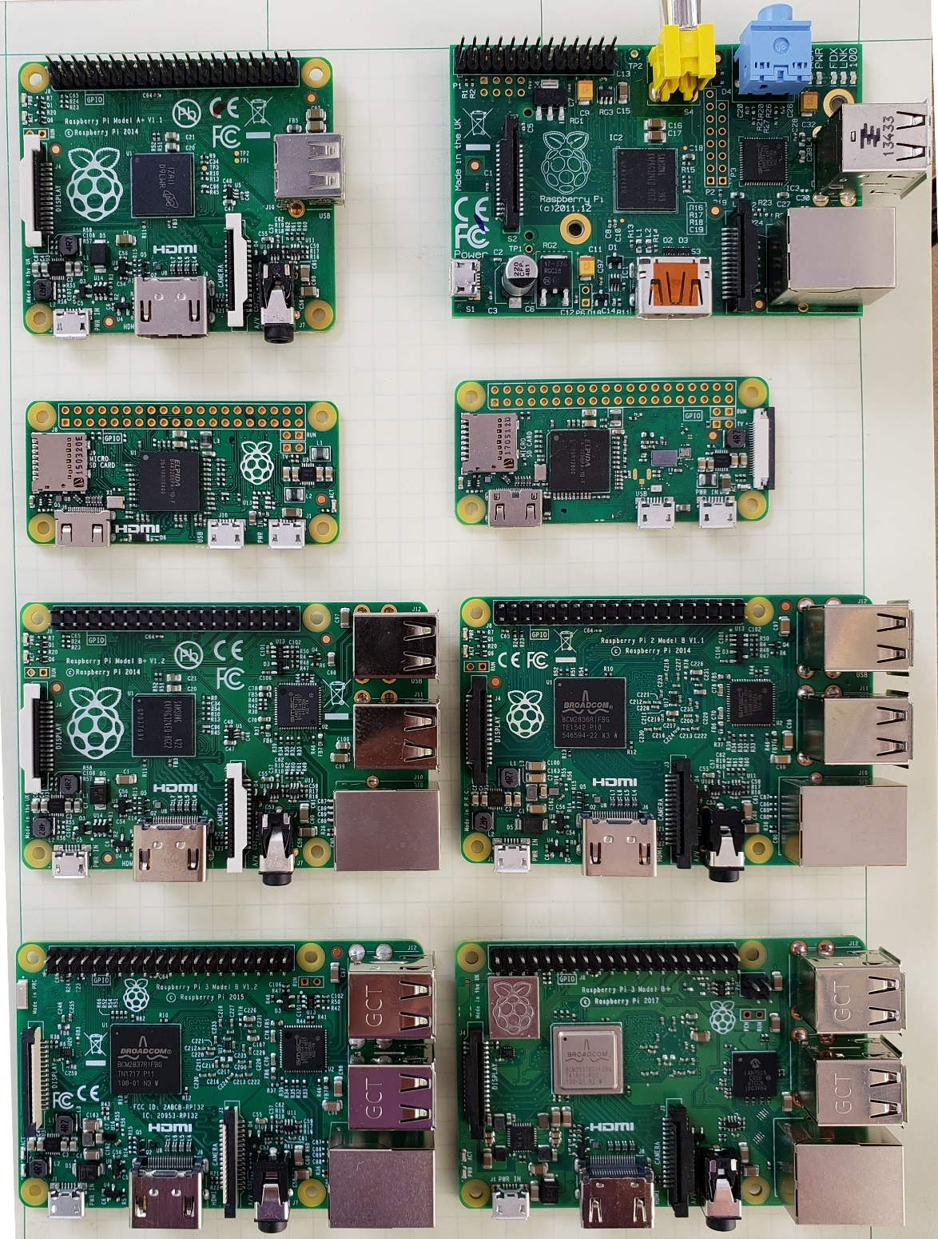
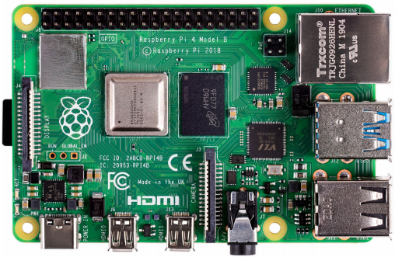
A+
B
Zero
Zero W
B+
Pi2
Pi4
Pi3
Pi3+

Slide 14



For More Maker Board Information
https://media.digikey.com/Resources/Maker/the-original-guide-to-boards-2019.pdf

Slide 15

Some Raspberry Pi Resources
TM Raspberry Pi Foundation www.raspberrypi.org
Good Links and web sites:
www.raspberrypi.org —The Foundation’s Website
www.raspberrypi.org/downloads — Various Raspberry Pi Operating Systems
www.adafruit.com — Adafruit very good site for parts and tutorials
learn.adafruit.com/category/raspberry-pi —Many projects and how to’s at Adafruit
www.sparkfun.com —Raspberry Pi parts and many other Hobby parts. (Colorado Co.)
www.newark.com —Low priced Raspberry Pi Parts
www.microcenter.com —Online and In Store Raspberry Pi
http://www.instructables.com/howto/Raspberry+Pi/ Lots of good Pi Tutorials
https://github.com/Chuckduey/CSU_Pi_Class.git GitHub page with the code from this class.
My email cduey@msn.com

Slide 16







Raspberry Pi Raspbian Versions
Initial Release Date | Current Release Name | Debian Version | Linux Kernel | GCC | apt | X Server | Raspberry Pi 1/1+ | Raspberry Pi 2 | Raspberry Pi 3 | Raspberry Pi 3+ | Raspberry Pi 4
2013-09-27 | 2015-05-05 | 7 (Wheezy) | 3.18 | 4.7.2 | 0.9.7 | 7.7
2015-09-28 | 2017-07-05 | 8 (Jessie) | 4.9 | 4.9 | 1.0.9.8.1 | 7.7
2017-09-08 | 2019-04-08 | 9 (Stretch) | 4.14 | 6.3 | 1.4.9 | 7.7
2019-06-24 | 2019-07-10 | 10 (Buster) | 4.19 | 8.3 | 1.8.2 | 7.7
Buster
©

Slide 17
Important Raspberry Pi Tips
Do Not add or remove hardware while running. Including USB devices. Plugging in a mouse at the last minute can kill the SD card.
Power down the Raspberry Pi using a software command before removing power. SD corruption is very common on uncontrolled power downs.
SD cards are fragile and also wear out. Keep a backup copy of your code. It is best to store it on a network drive.
SD cards come in various speeds and sizes. Class 10 is the fastest. For the Raspberry Pi 32GB is the maximum size. (SD limitation)
The Raspberry Pi I/O ports are 3.3V. A 5V signal will render the port, and possibly the whole Pi useless.
The Micro SD cards are very easy to pop out accidentally. If it does while it is running, resist the temptation to plug it right back in. Power down first!!!

Slide 18
Useful Tools
Linux or MAC computer with USB and network.
With a Linux computer, it makes it easy to copy, change and back up Raspberry Pi SD cards using the “dd” command.
Also the ssh, and ssh –X makes it easy to remote in to work.
Win32 Disk Imager - A perfect tool copying and backing up Raspberry Pi SD cards. Do not do a direct SD to SD copy.
PuTTY - creates a terminal window that can be used to “ssh” to any Linux computer on you network from a windows machine.
VNC/ RealVNC – VNC can display a desktop to another computer Linux or Windows. Very nice for remote work from different platforms.
USB power 2A or more - While most computers are limited to 500mA of current on the USB port, it is easy to have more current draw from a Raspberry Pi with accessories.

Slide 19
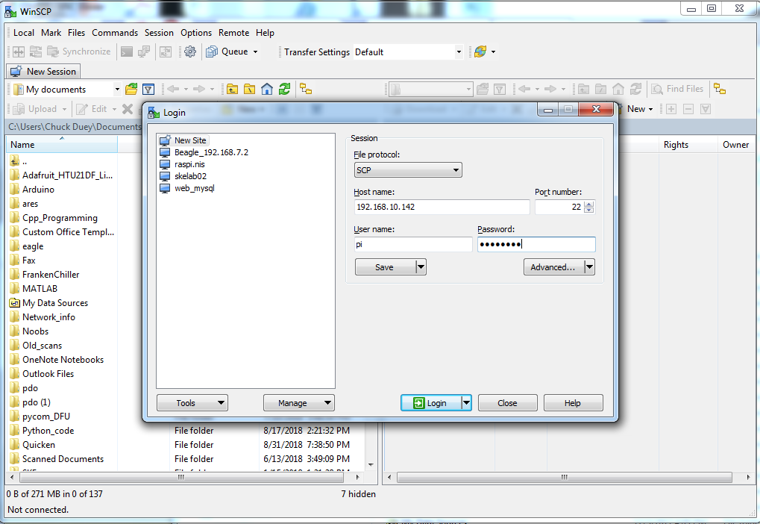
WinSCP File browser between Pi an PC

Slide 20
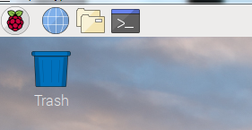
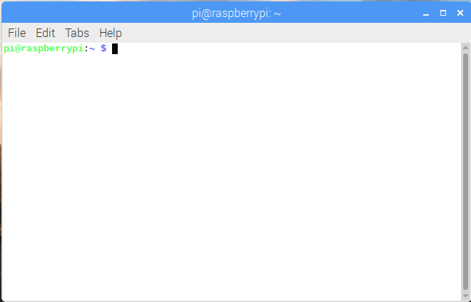
Open a Pi Terminal
Click Here
Tips: <Tab> Auto complete
Left mouse to select for copy, Center mouse to paste.
^c to stop a command
Up Arrow to through previous commands.
Left and Right arrows to edit line.

Slide 21
Terminal window commands
ls = list files in directory ls –l = List long ls –a = List all
cd (dir name) = change directory
df –h = Show file systems sizes and usage
nano (file) = Simple intuitive text editor
vi (file) = Simple powerful non-intuitive test editor.
cat (file) = output the contents of a file
less (file) = output a file one page at a time
apt-get install (package) = get an package to install
apt-get update = update packages
apt-cache show (key word) = show available packages
sudo = next command execute as root
ifconfig = show the ip interface connections
history = commands run in the past. !(number) re-runs

Slide 22
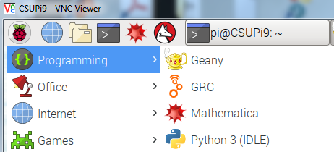
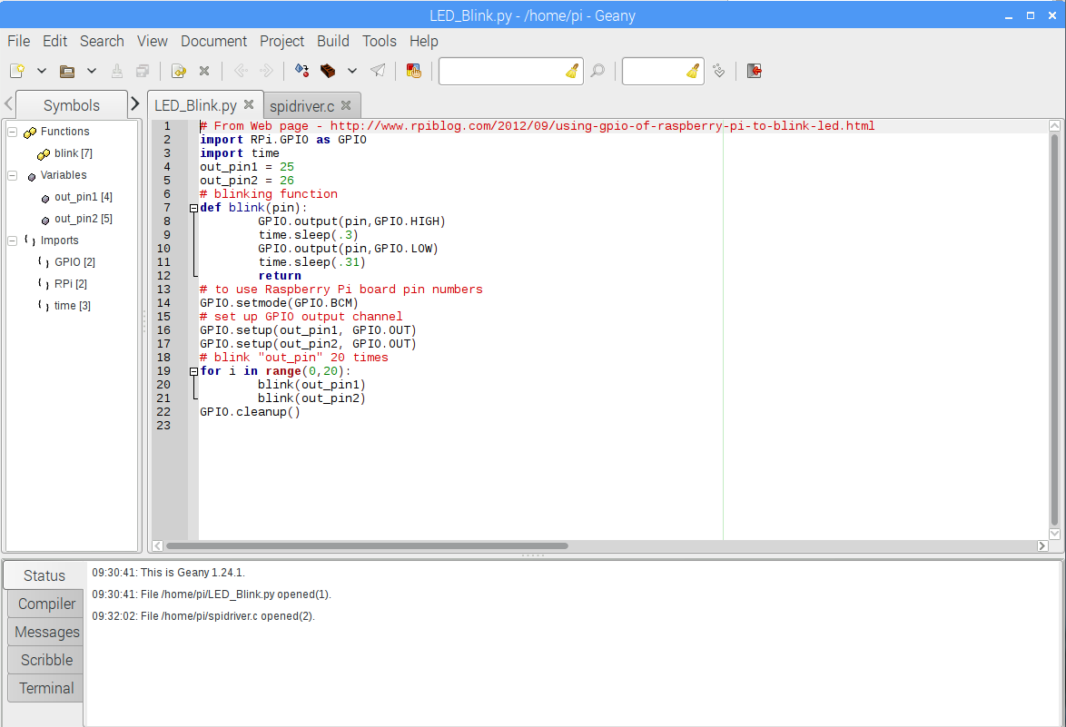
Text Editor with Code Context “Geany”

Slide 23
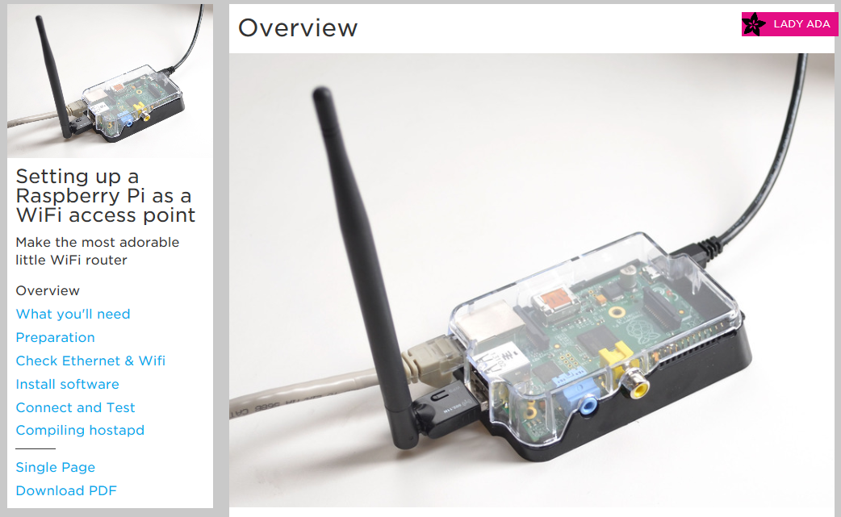
Raspberry Pi as Wireless Access Point
https://learn.adafruit.com/setting-up-a-raspberry-pi-as-a-wifi-access-point?view=all
When ever setting up an Access Point be sure to use a secure passcode with WEP/WPA

Slide 24
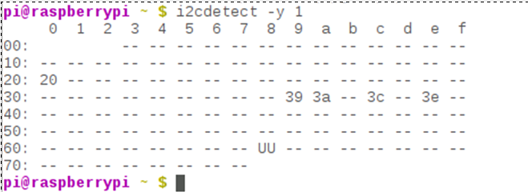
Raspberry Pi I/O*
GPIO
Good for Controlling devices like relays, LEDs etc.
Also can be used as inputs. Can be made to implement bus system.
UART/Serial – 2 Wire interface 3.3V
Good for GPS, RS-232 Monitor, and many others.
Baud rates up to 115200 bps
SPI Serial 4 Wire interface. (MOSI, MISO, SCLK, CE) 3.3V
2 Chip Selects built in. Easy connections to many serial sensors.
Speeds can be between 8KHz to 125MHz
This can be used to run an LCD Screen
I²C Serial 2 Wire Interface. (SDA, SDL) 3.3V
Multiple devices with 7 bit address. Up to 127 - 11
Much slower 400Kbps For Raspberry Pi.
Great for touch screen sensors.

Slide 25
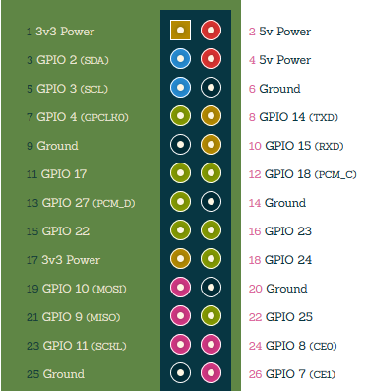
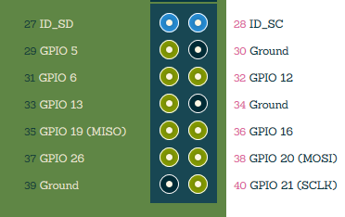
GPIO Pin out*
All Others Extra pins
Note: GPIO pins are 3.3V Only
A 5V input will cause damage to the Raspberry Pi!!!
Pi A and B Pin Out
*From http://pi.gadgetoid.com/pinout

Slide 26
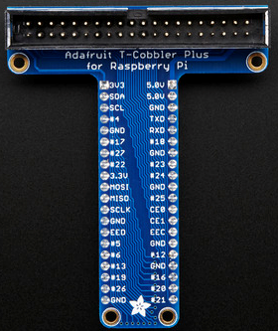
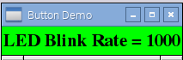
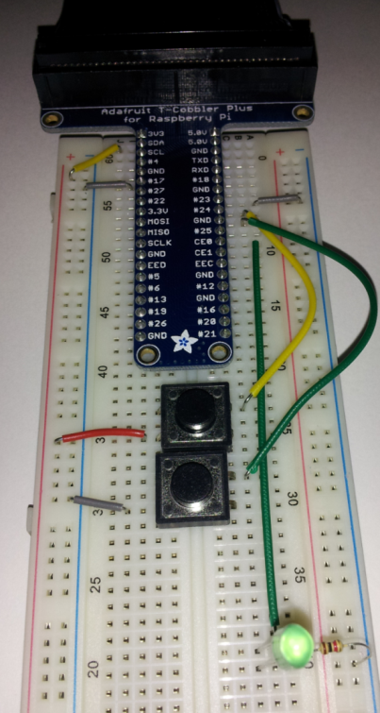
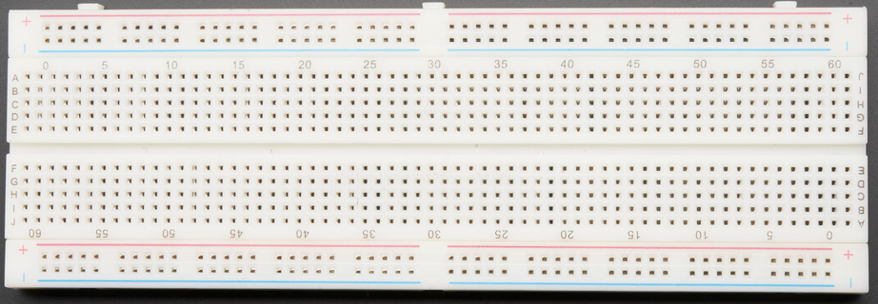
Now For Fun and Games with the Pi

Slide 27
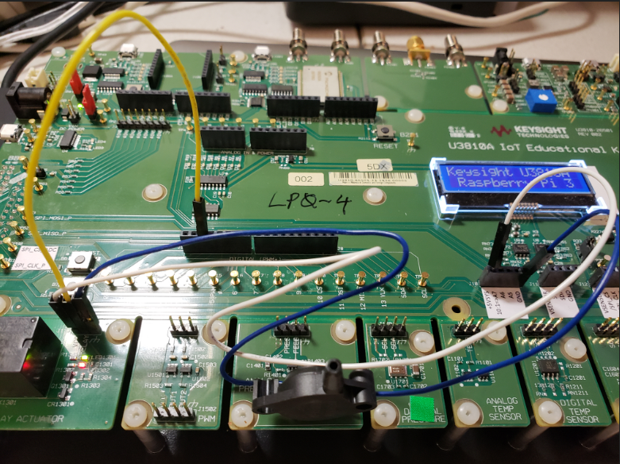
Hook up Relay
Connect Relay to Pin 3 of J9
Connect VDD to +5VSYS on J10, and GND on the same J9

Slide 28
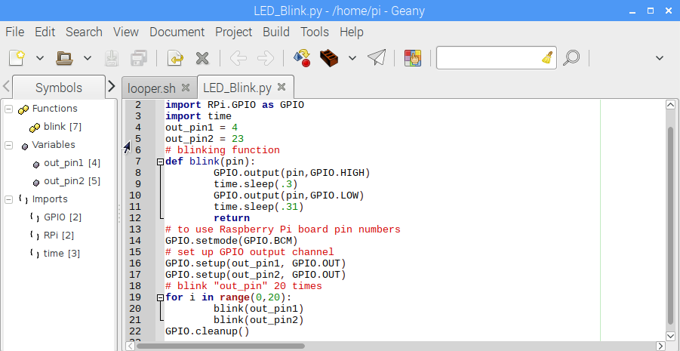
Geany looper.sh and LED_Blink.py
Run
Run “python LED_Blink.py” first then “./looper.sh”

Slide 29
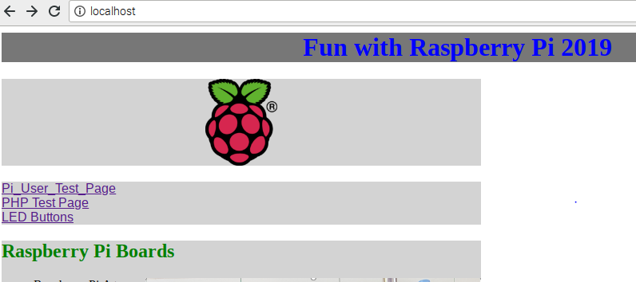
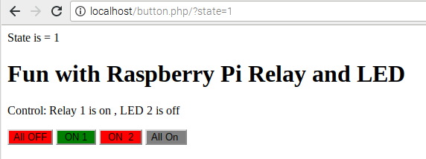
Web Page LED Control
Click Here
Turn on and off your Relay

Slide 30
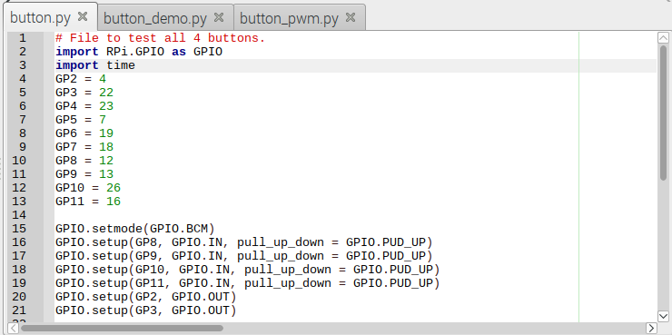
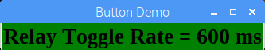
Geany button.py, button_demo.py and button.pwm.py
python button.py - Press buttons….It senses, but it is a polling routine
python button_demo.py - Buttons now are set up as events.

Slide 31
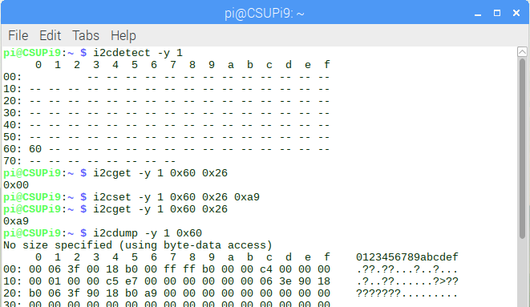
I2C Bus and Tools
The i2c bus is a bidirectional bus with 2 lines SDA and SCL.
This bus can have up to 117 devices.
i2cdetect - Show the devices on an i2c bus
i2cget – read a register value from an i2c device
i2cset – write a value to an i2cdevice.
i2cdump – dump all the values available from an i2cdevice.

Slide 32
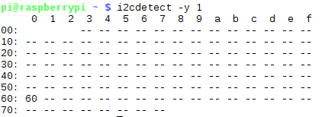
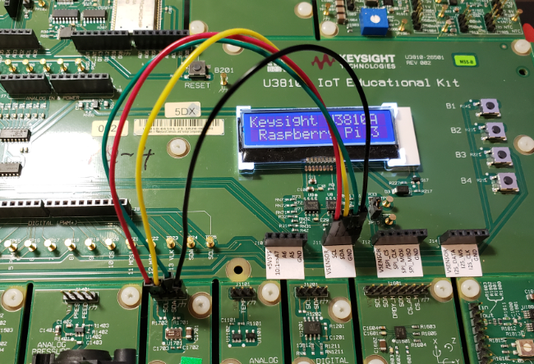
Hook up the I2C Pressure temp sensor
Connect J11 GND to Ground on Pressure sensor
Connect J11 VSENSOR to VDD on Pressure sensor
Connect J11 SCL to SCL and SDA to SDA
I2cdetect –y 1 - You should see if it is correct

Slide 33
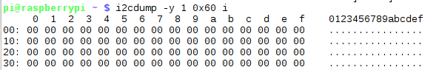
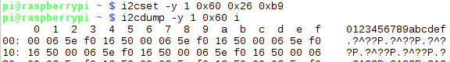
i2cdetect –y 1 – and see if it is hooked up
i2cdump –y 1 0x60 i :look at the values
i2cset –y 1 0x60 0x26 0xb9 :dump again

Slide 34
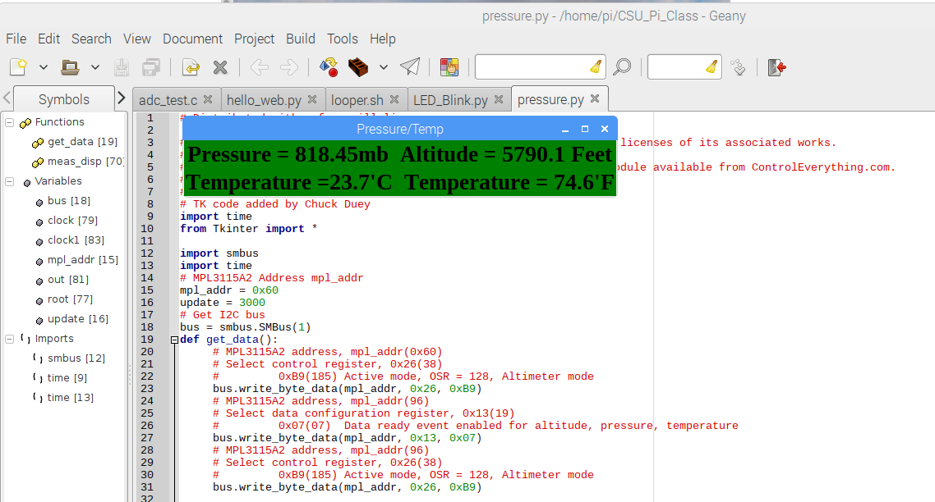
Geany pressure.py : See the output of the Pressure sensor

Slide 35
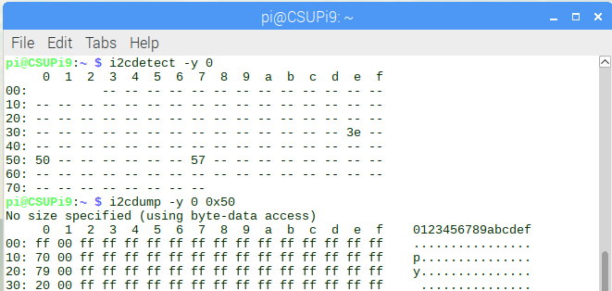
Look at a whole other i2c bus
i2cdetect –y 0

Slide 36
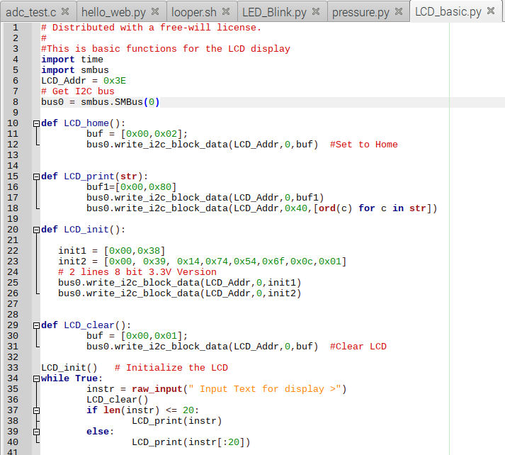
Geany LCD_basic.py – Explore i2c LCD

Slide 37
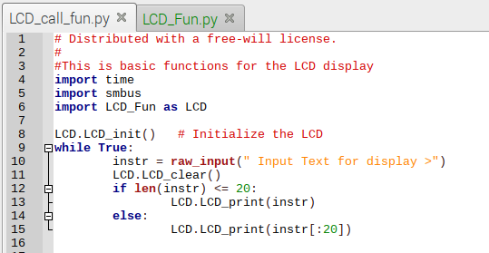
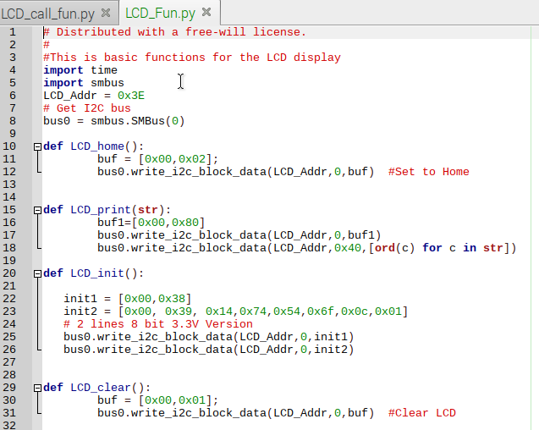
Geany LCD_call_fun.py – Python Function

Slide 38
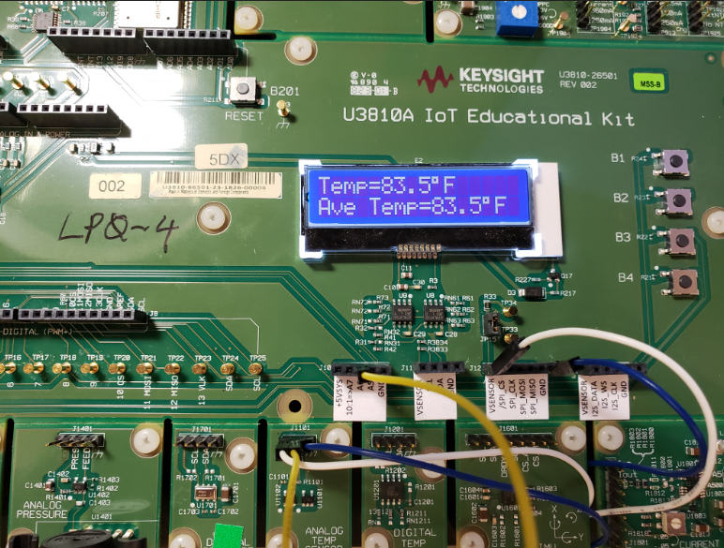
SPI and ADC
The SPI interface is a much higher speed interface than the I2C. This uses 4 lines. MOSI, MISO, CLK, and CS.
Here we will be using the MCP3208 ADC on the SPI Bus.
Hook up the Analog Temperature sensor. Connect TEMP to J10 “A6” Pin for the analog input
Hook up VDD to J12 VSENSOR and GND to the same J12

Slide 39
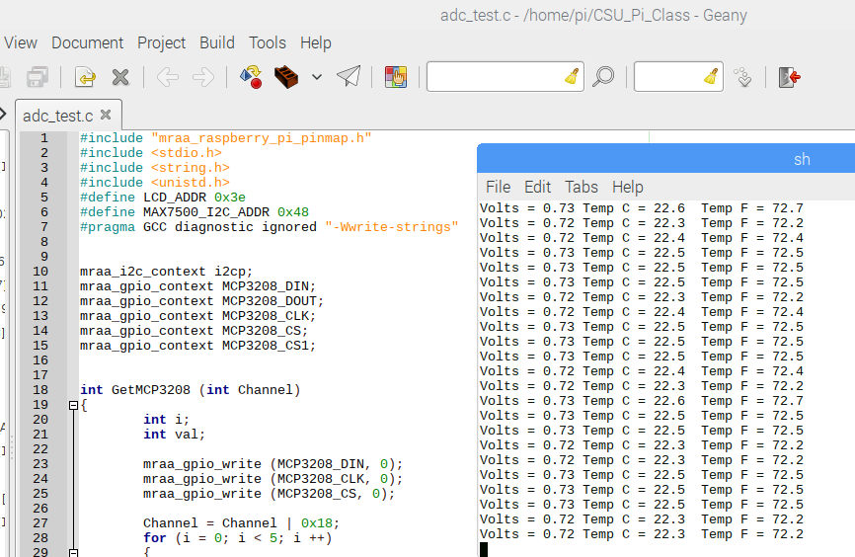
Open adc_test.c with Geany, compile, link, and run
Compile
Link
Run

Slide 40
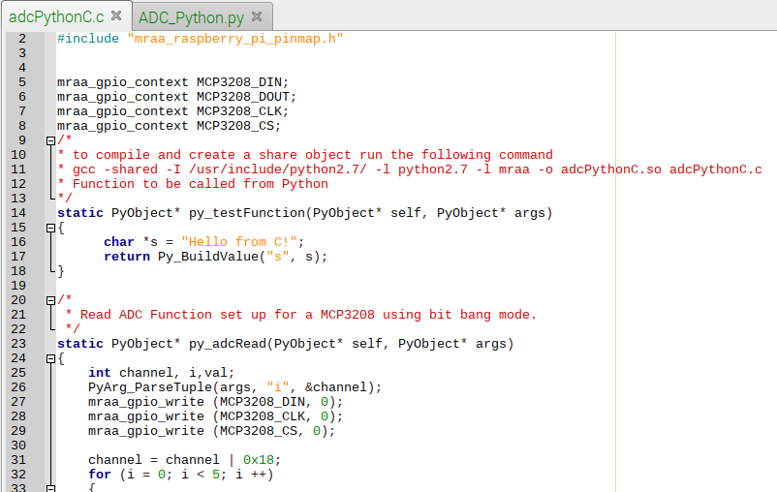
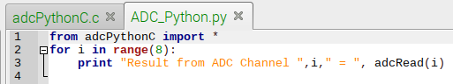
Use C Bit-Bang SPI in Python
Open adcPythonC.c and ADC_Python.py. Run the ADC_Python.py file.

Slide 41
IOT Security
0. Do not use Default Passwords
1. Never store plain text passwords use MD5/SHA hash.
2. Wireless use encryption. (WEP)
3. Use secure sockets when communicating beyond local
network. HTTPS over HTTP. ngrok can be used.
4. Use SSH which uses TLS/SSL Transport Layer Security
/ Secure Socket Layer
5. Only open required sockets.
6. Make sure your socket can take anything. Buffer
over-runs have been used as successful attacks.

Slide 42


Communicating Via Sockets
In Geany open up socket_server.py, socket_client.py and socket_cl_addr.py
In one terminal start up the Socket Server “python socket_server.py”
In a different terminal run a “ python socket_client.py” and send a message.

Slide 43

Now for some fun over the LAN
Find your IP address by typing “ifconfig” Trade addresses with neighbors
Then use “python socket_cl_addr.py” to send data to your neighbor.
This is a nmap probe looking at this port.
If there is an open port, be prepared for it to be probed!

Slide 44

When Ever Opening a Port Make it Resilient

Slide 45
Different reserved port functions
21 – FTP File Transfer Protocol
22 – SSH/SCP – SSL/TLS Secure Socket Layer
23 – Telnet – Unencrypted communications
80 – HTTP – Primary HTTP port
443 – HTTPS – HTTP over SSL/TLS Encrypted connection
*Requires third party certificate to authenticate.
We will need stop the existing web services: Type
sudo service apache2 stop

Slide 46




Looking at basic HTML and Serving via Request Response Cycle
Geany hello.html and hello_web.py
sudo python hello_web.py

Slide 47

In a Web browser open localhost

Slide 48

Now for some Real Fun!
sudo python web.py
Open a webpage to localhost
Watch your LCD

Slide 49

Open “web.py” with Geany.py
All the pieces are together

Slide 50

Close your web browser to localhost and Share ip addresses and open other lab station webpages

Slide 51

There is an observer on the network

Slide 52

‘ngrok’ is a tool to secure your data
Open another terminal window and enter ‘./ngrok http 80’
Use the https address listed in your terminal. This can also be used by any web browser connected to the internet.

Slide 53

Wireshark Data Capture HTTPS via ngrok

Slide 54

Even running on the Pi, the Data cannot be read

Slide 55
Thanks !!! Have Fun With Raspberry Pi

Slide 56
Steps to create the system
Download latest NOOBS and update.
Enable SSH, VNC, I2C, Serial.
In /boot/config.txt turn on i2c_vc
Download mraa and CSU_Pi_Class form github.
sudo apt-get install cmake automake libpcre3-dev byacc flex swig3.0
In mraa $> mkdir build cd build
cmake -D BUILDSWIGNODE=off -D CMAKE_INSTALL_PREFIX=/usr ..
$> make $> sudo make install (sudo ln -s libmraa.so.2.0.0 libmraa.so.1)
sudo apt-get install apache2 php7.0 octave
cp –R CSU_Pi_Class/html/* /var/www/html/.
sudo ln –s /home/pi/CSU_Pi_Class/html/test.html /var/www/html/test.html

